Slide 1
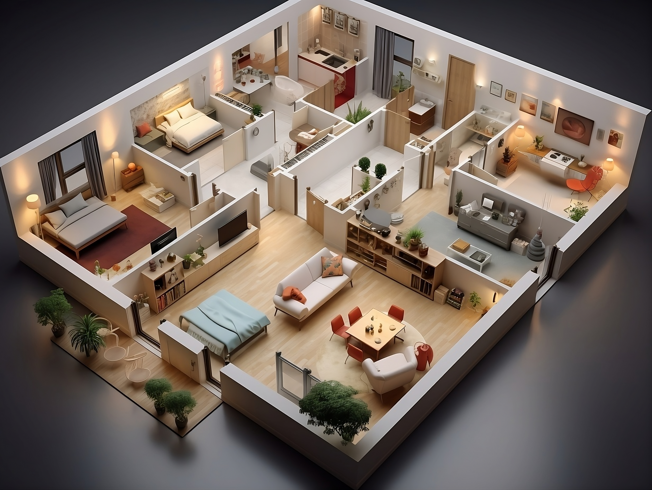
Advanced AI-Driven Architectural Design System for Dynamic Floor Plan Generation
Group ID:
F24SE015
Presented by:
Zain Bin Imran
Muhammad Mazhar Rehan
Usama Bin Naseer

Slide 2
Problem Statement
Challenges in Floor Plan
🔹 Requires professional expertise
Inaccessible to non-experts. 🔹 Manual-driven process
Time-consuming & costly. 🔹 Existing AI tools lack real-time generation
Limited user interaction. 🔹 No publicly available datasets
Need for custom dataset creation. 🔹 Lack of CAD integration
Need AI-driven floor plan customization for seamless workflow.

Slide 3
Objectives & Scope
Objectives
Reduce floor plan creation time through AI automation.
Improve accessibility to professional-grade architectural tools.
Enable dynamic, real-time AI-generated floor plans based on user input.
Integrate validation mechanisms to ensure accuracy.
Scope
📌 Current Focus: Residential ground floor plans. 📌 Future Expansion: Multi-story buildings, commercial layouts, and exterior designs.

Slide 4
System Architecture
🎯 How Our System Works
User inputs building parameters (e.g., rooms, layout preferences).
CGAN generates a custom floor plan dynamically.
CNN validates correctness & provides real-time feedback.
Users can export plans in DXF, PNG, PDF formats.
Cloud-based deployment for real-time performance.

Slide 5
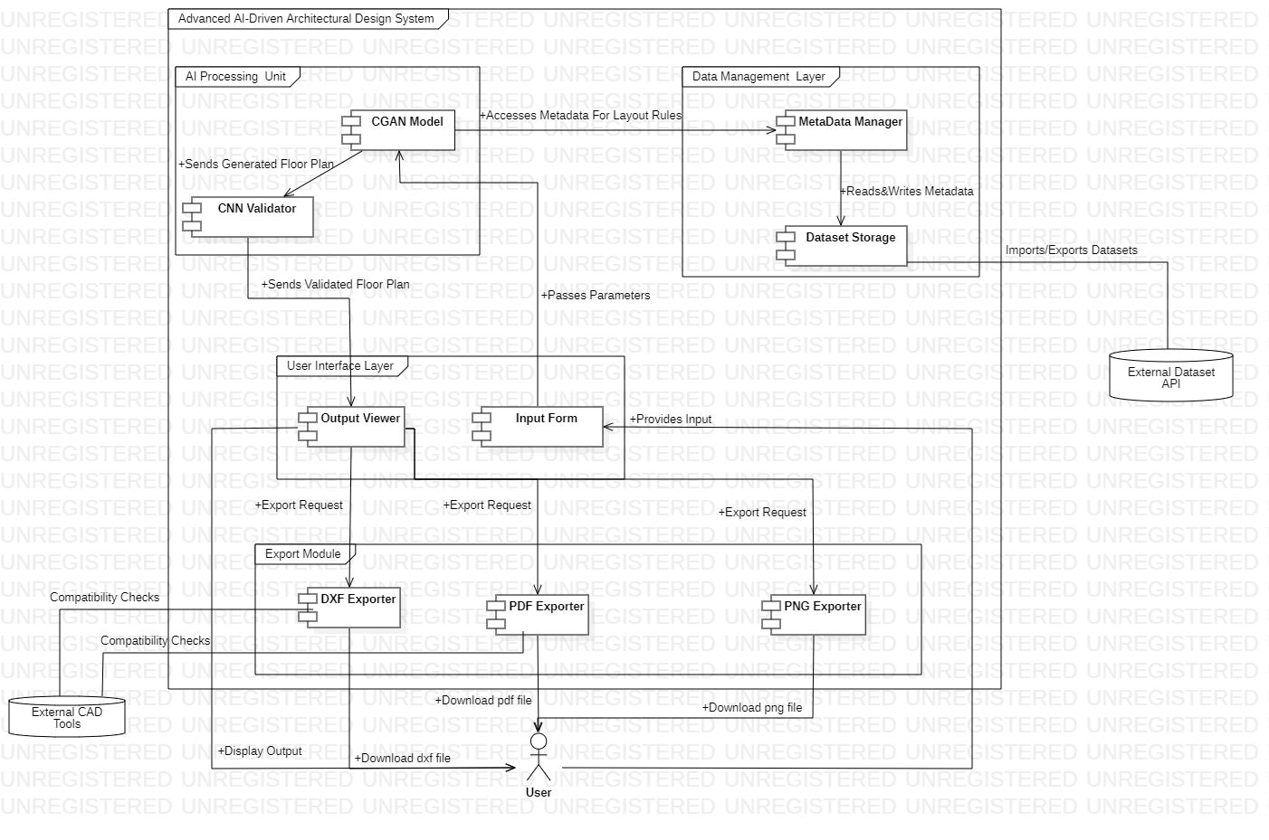
High-Level Context Diagram

Slide 6
Technical Architecture
🛠 AI & Machine Learning Tools ✅ PyTorch – Model training (CGANs, CNNs) ✅ OpenCV – Image preprocessing & feature extraction ✅ NumPy & Pillow – Data handling & augmentation
🌍 Cloud & Deployment ✅ AWS EC2 – AI model hosting ✅ AWS S3 – Dataset & user storage ✅ AWS RDS – Database for logs & metadata
📐 Development Stack ✅ Django (Backend) – API for AI model interaction ✅ ReactJS (Frontend) – Interactive UI for floor plan visualization ✅ ezdxf – CAD format support for AutoCAD exports
✅ Database: PostgreSQL

Slide 7
Dataset Development
🔹 No Existing Dataset → Created Our Own! ✅ Manually created 200+ floor plans in Visio ✅ Labeled metadata for architectural correctness ✅ Exported in PDF, PNG, DXF formats
🔹 Data Preprocessing
Resizing & Normalization → Standardized image sizes
Feature Extraction (OpenCV) → Edge detection & object segmentation
🎯 Ensured diverse training data for AI model accuracy.

Slide 8
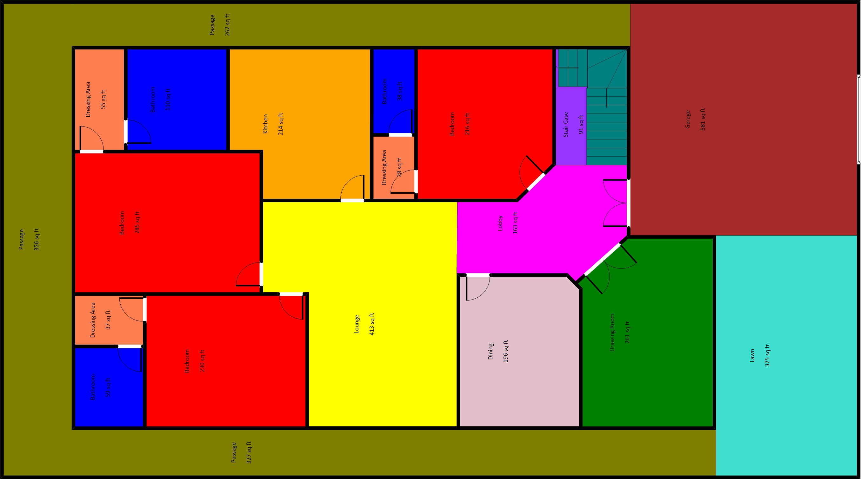
Floor Plan

Slide 9
AI Model Strategy
🎯 Why CGANs? (Conditional GANs)
Generates floor plans dynamically based on user input.
Captures architectural constraints (room size, spacing).
🎯 Why CNNs? (Convolutional Neural Networks)
Validates structural accuracy (no overlaps, correct spacing).
Ensures real-world architectural feasibility.
📌 Training Workflow
Train CGANs to generate realistic floor plans.
Train CNNs to validate floor plan correctness.
Feedback Loop: Refine based on AI mistakes.

Slide 10
Current Achievements
200+ manually created floor plans in Visio
Data Preprocess and Label Data
Normalized the Dataset
Data Augmentation
Develop Frontend
Finalize tools and technologies
Model Selection

Slide 11
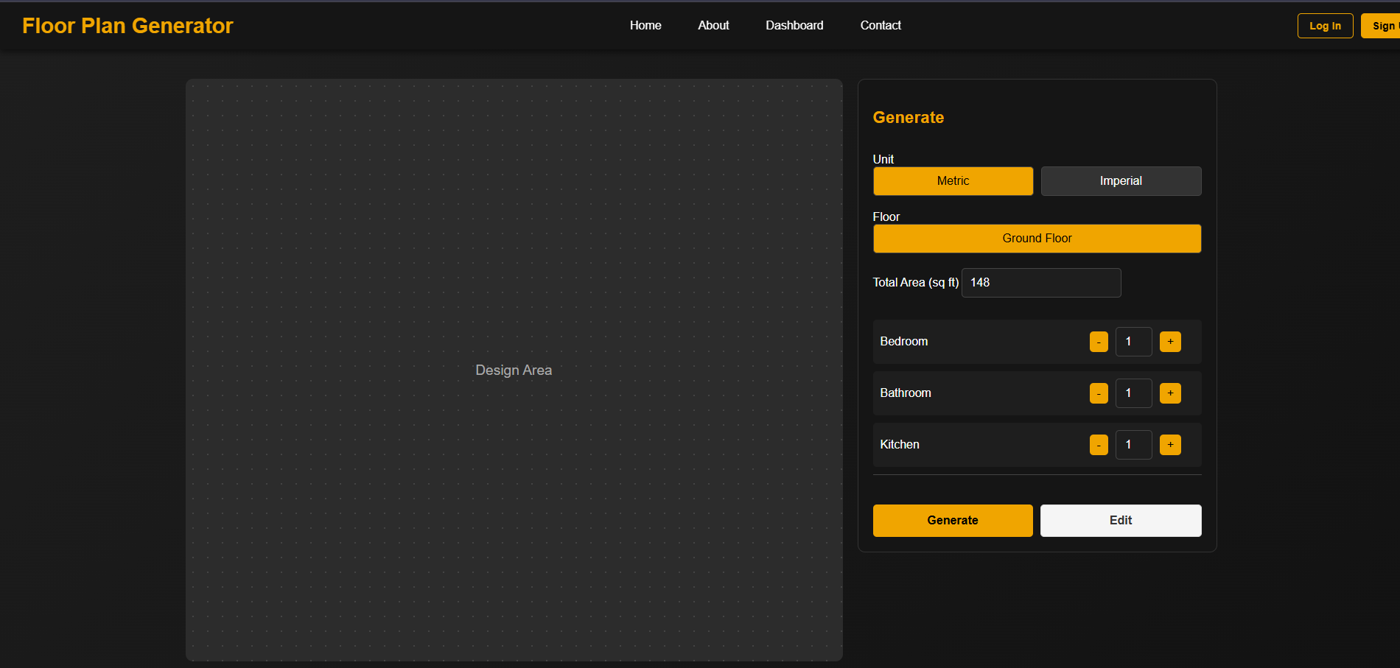
User Interface

Slide 12
Challenges & Solutions
Challenge | Solution Implemented
No existing dataset | Manually created 200+ floor plans
CGAN model instability | Optimized loss function & hyperparameters
Ensuring real-time AI performance | Deployed cloud-based AI inference
CAD export compatibility | Integrated ezdxf for seamless DXF conversion

Slide 13
Future Enhancements
✅ Expand dataset to 500+ floor plans. ✅ Train CGANs for multi-story buildings. ✅ Develop API integration for CAD software compatibility. ✅ Improve AI model self-learning with reinforcement techniques.
Deploy complete system
🚀 "Our system is evolving into a fully functional AI-driven design platform."

Slide 14
Conclusion
🎯 Key Takeaways ✔ AI-driven system generates real-time dynamic floor plans. ✔ Trained AI models (CGANs, CNNs) ensure correctness. ✔ Cloud-hosted deployment ensures fast, scalable performance. ✔ Seamless integration with CAD tools for professional usability. ✔ Strong roadmap for multi-story, & API support.
🌟 Final Vision: "To create an AI-powered architectural design assistant that transforms real estate planning."

